Slide 1
Farmers Ville
Naga Krishna Vadlamudi Manoj Prabhakar Ejjirothu Sudheer Kumar Nagaruri Pratap Kadari

Slide 2
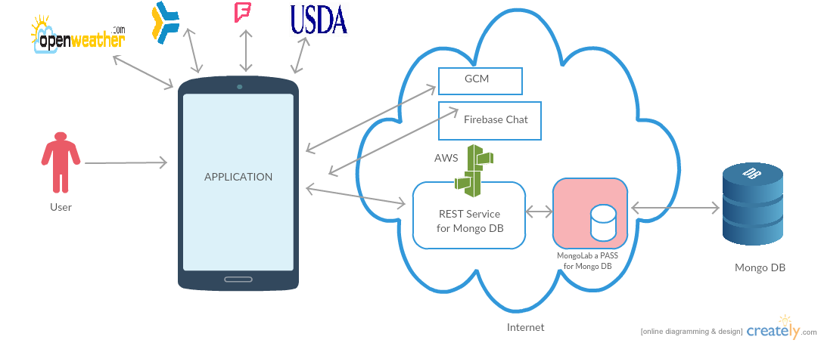
Architecture Diagram
Technologies Used: Amazon Web Services, Mongo Lab, Firebase,
Google Cloud Messaging, Android

Slide 3
Application Features
Users can create an account and login to the App
Weather Forecast for next 5 days
Post his product details & edit, delete post.
Get details of seller to buy product
Chat with Seller
Live market prices, notifications on product price change
Suggestions to crops – Fertilizers, insecticides
Current News
Market Locations
Manage Users profile

Slide 4
Future Scope
Adding reviews for each seller
Get currently cultivating crops from farmer and push notification accordingly

